Slide 1
Selenium Course Session 3

Slide 2
Objectives
Dealing with Dynamic WebElement(s)
Storing WebElement(s)
ExplecitWait
ExpectedConditions
Selenium Assertions
Exceptions

Slide 3
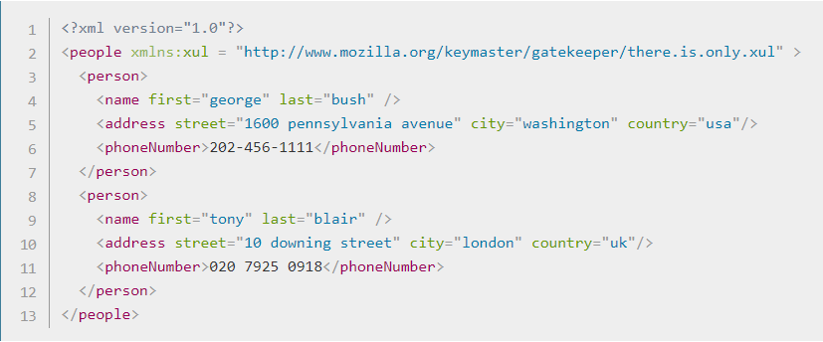
Xpath Axes..
Relationship of Nodes:
Parent
Children
Siblings
Ancestors
Descendants

Slide 4
Syntax / relationship:
Following: Goes to any node after a the current node. Example, //*[@type='text']/following::input //*[@type='text']/following::input[1]
Ancestor: Goes to any node before a the current node. Example, //input[@name='password']/ancestor::table
Child: Goes to all children nodes within the current node. Example, //form[@name="frmLogin"]/child::table
Preceding: Goes to all nodes that come before the current node. Example, //input[@type='password']/preceding::input
Following-sibling/preceding-sibling: Goes to all nodes that come after the current node on the same level. Example, //input[@type='password']/following-sibling::label
Parent: Goes to the immediate parent node of the current node. Example, //input[@type='password']/parent::td
Descendant: Goes far down the line of the current node. Example, ​//div[@class="container-fluid"]/descendant::a

Slide 5
Store Web Element
Syntax:
WebElement NAME_ELEMENT = driver.findElement(By.xpath(" "));
By NAME_LOCATOR = By.xpath(" ");
Explicit Wait
Syntax:
WebDriverWait wait = new WebDriverWait(driver, 60);
wait.until(ExpectedConditions.visibilityof(driver.findElement(By.name(" "))));

Slide 6
Expected Conditions
elementToBeClickable()
invisibilityOfTheElementLocated()
presenceOfElementLocated()
visibilityOfElementLocated()

Slide 7
Assertions in Selenium
Assertions provide a means for users to validate any kind of test.
The Assertion results are based on the comparison of Actual & Expected Results.
Commonly used Assertions:
Assert True
Assert False
Assert Equals
Assert Not Equals

Slide 8
Exceptions..
NoSuchElementException
FileNotFoundException
TimeoutException
IOException
AssertionError
The printStackTrace() method is used to print the Throwable along with other details like class name and line number where the exception occurred.

Slide 9
Homework
Automate the following test case:
Scenario: Users will be able to add deposit
1: Open Browser and go to site http://www.techfios.com/billing/?ng=admin/
2. Enter username: demo@techfios.com
3. Enter password: abc123
4. Click login button
5. Click on Bank & Cash button
6. Click on New Account button
7. Fill out the Add New Account form
8. Click on submit button
9. Visually check if the account has been created
Visually check to make sure the deposit posted

Slide 10
Interview Questions
What is assertion?
What are some ways you can use assertion?
what is the difference between assertion and verification?
What are the challenges of automation?
What are some common exceptions you have experience with?
How can you handle exceptions?

